Slide 1
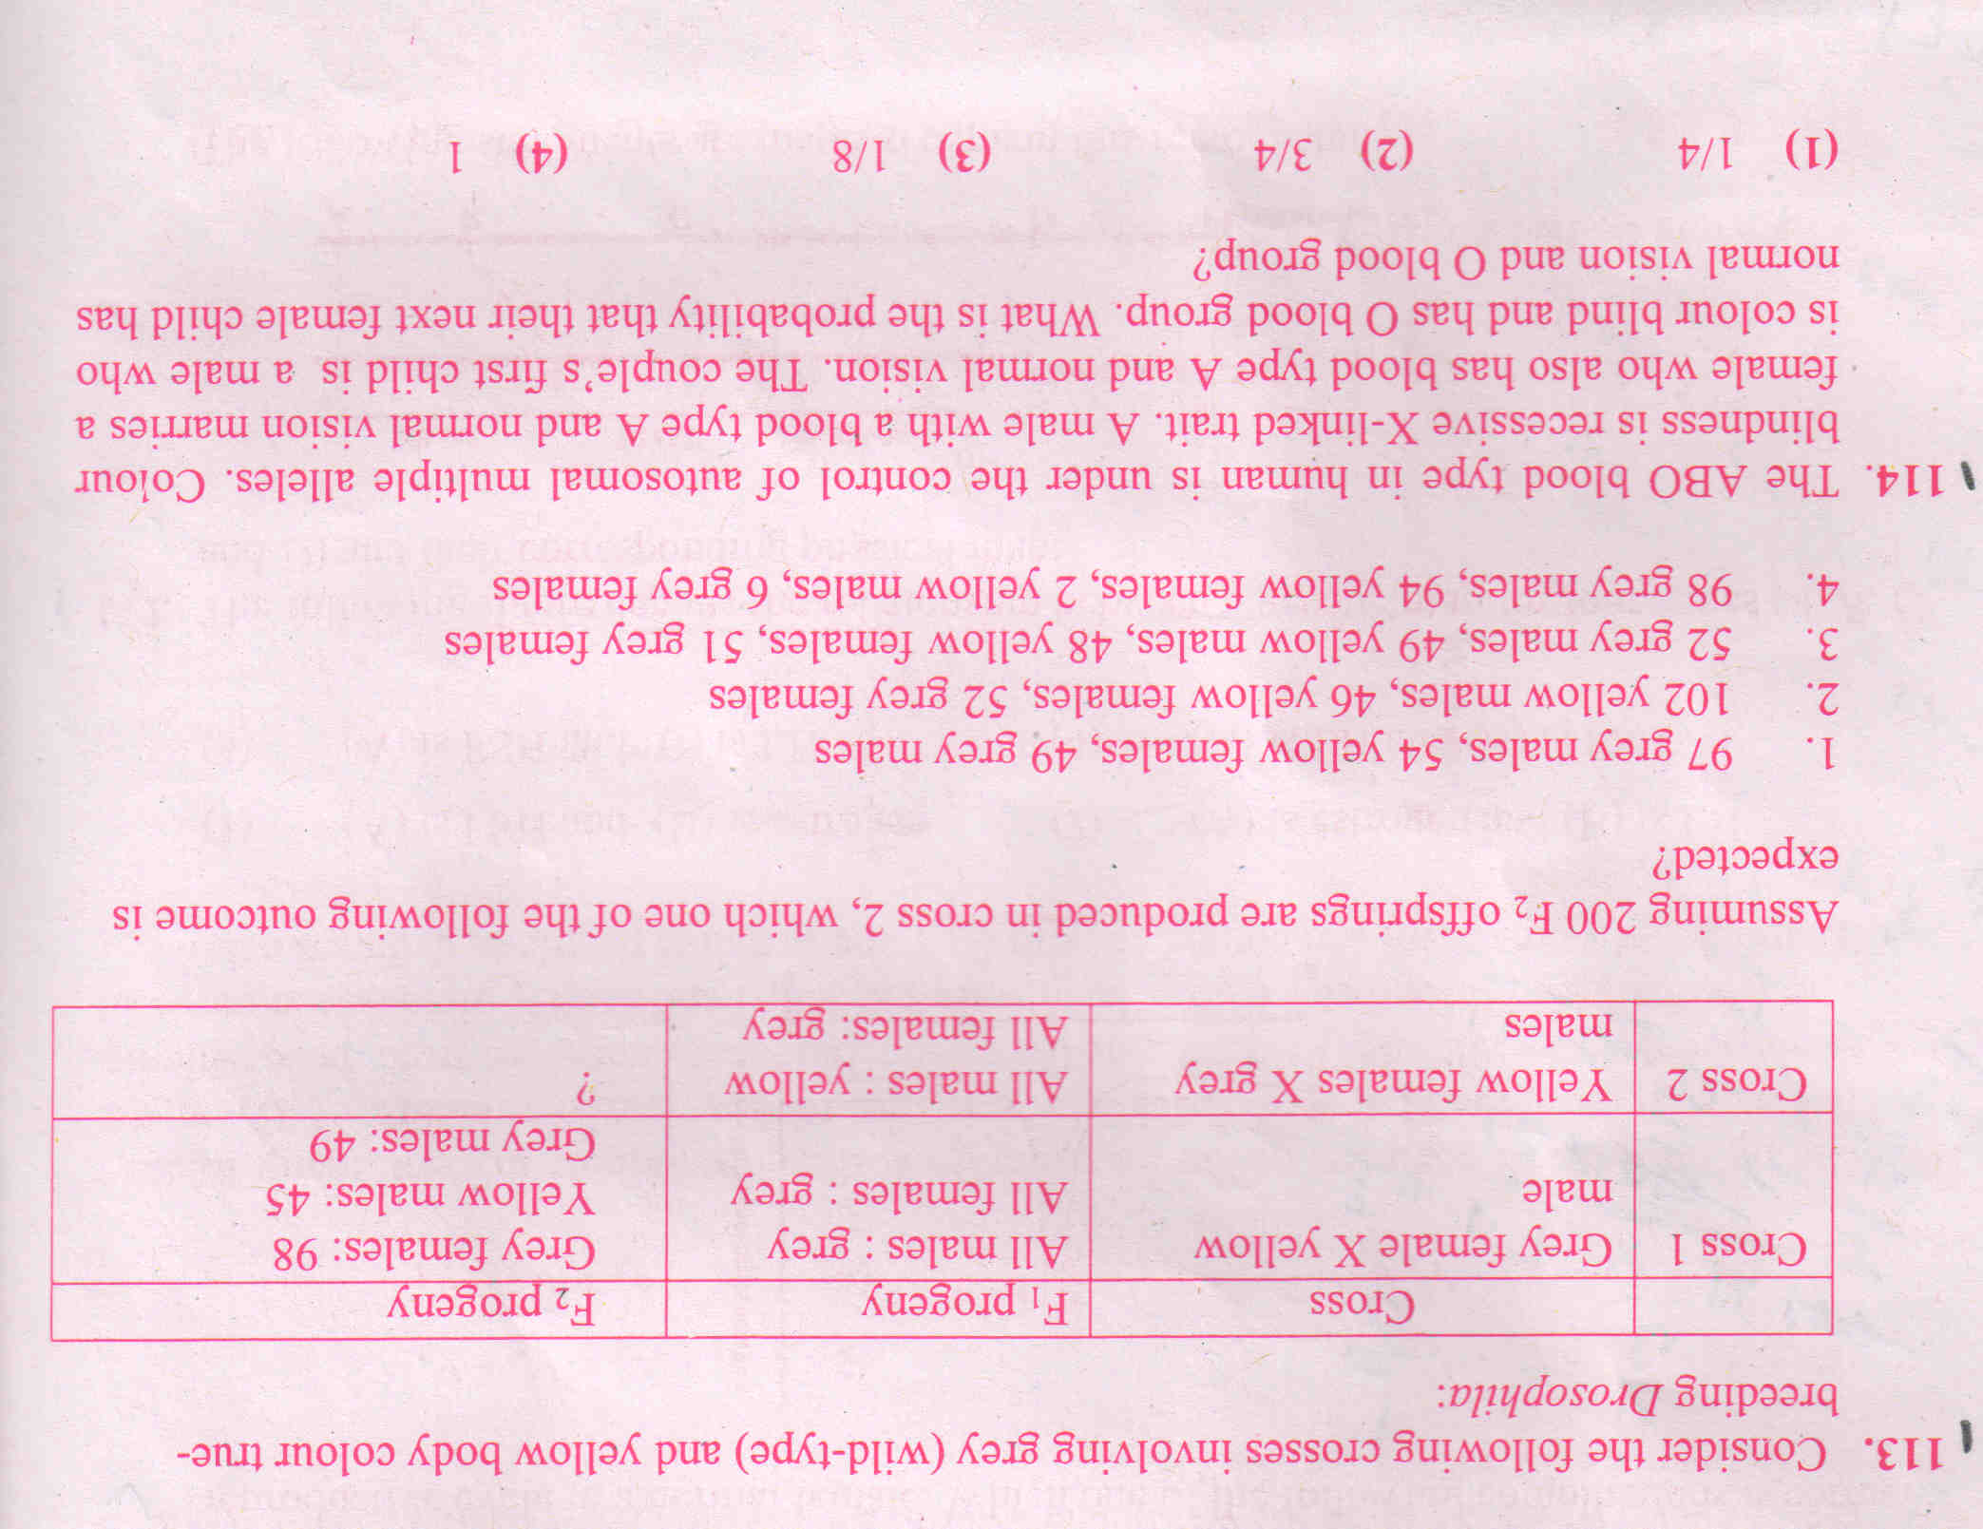
Questions!!

Slide 2
Pedigree Analysis
A pedigree is a diagram of family relationships that uses symbols to represent people and lines to represent genetic relationships.
Pedigrees are often used to determine the mode of inheritance (dominant, recessive, etc.) of genetic diseases.

Slide 3
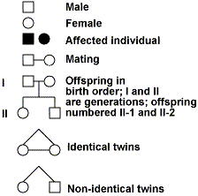
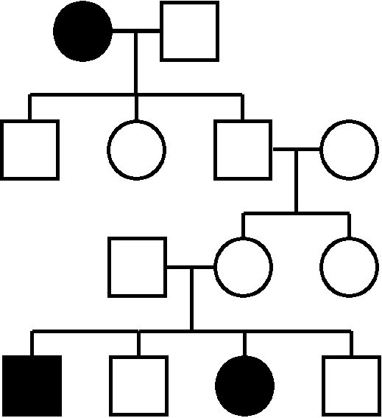
A sample pedigree chart

Slide 4
Pedigree Chart
Squares represent males and circles represent females. Shade in the symbol represent affected individual
Horizontal lines connecting a male and female represent mating.
Vertical lines extending downward from a couple represent their children.

Slide 5
Allele Segregation
Chr 1
Chr 2
A
a
B
b
BbAa- genotype
2N
N
N
N
N
a
A
A
a
b
B
b
B
GAMETE 1
GAMETE 2
GAMETE 3
GAMETE 4
ba- genotype
BA- genotype
bA- genotype
Ba- genotype

Slide 6
Allele Segregation
Chr 2
A
a
B
b
BbAa- genotype
2N
Recombinants
Recombinants
N
N
N
N
a
A
A
a
b
B
b
B
GAMETE 1
GAMETE 2
GAMETE 3
GAMETE 4
ba- genotype
BA- genotype
bA- genotype
Ba- genotype

Slide 7
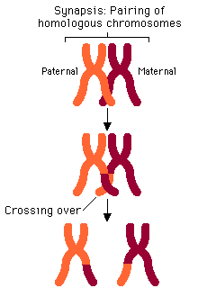
Crossing over results in Recombination of Alleles of different genes
B
B
b
b
A
a
a
A
b
B
b
B
A
a
a
A
B
B
b
b
A
a
A
a

Slide 8
Allele Segregation
Chr 2
A
a
B
b
BbAa- genotype
2N
Recombinants
Recombinants
N
N
N
N
a
A
A
a
b
B
b
B
GAMETE 1
GAMETE 2
GAMETE 3
GAMETE 4
ba- genotype
BA- genotype
bA- genotype
Ba- genotype
RATIO: 1:1:1:1 ?

Slide 9
Linkage, Recombination & Mapping of Genes

Slide 10
Mendel’s law of independent Assortment
The Law of Independent Assortment states that alleles of different genes assort independently of one another during gamete formation. (F2 ratio- 9:3:3:1)
However, in early 1900, Bateson and Punnet, were studying the inheritance pattern of 2 genes in sweet potatoes found that certain combination of alleles showed more often than expected , as though 2 genes were physically attached.

Slide 11
Linkage: The Phenomenon of Allele Association (Morgan)
pr/pr. vg/vg X pr ⁺ /pr⁺ .vg⁺/vg⁺
Gametes pr . vg pr ⁺ .vg⁺
F₁ dihybrid pr ⁺/ pr . vg⁺/ vg (self)
Dihybrid ratio of 9:3:3:1 was not observed.

Slide 12
Recombinant frequency to recognize linkage.
Analyze the percentage of recombinants by test cross.
A test cross, first introduced by Gregor Mendel, is used to determine if an individual exhibiting a dominant trait is homozygous or heterozygous for that trait.
Outcome of test cross- 1:1:1:1

Slide 13
Test cross results:
pr ⁺/ pr . vg⁺/ vg X
pr / pr . vg/ vg
Genotypes | No of progeny | Expected Ratio
pr⁺.vg⁺ | 1339 | 1
pr .vg | 1195 | 1
pr⁺.vg | 151 | 1
pr .vg⁺ | 154 | 1
Recombinants
2839
Observed Frequency of Recombinants= 151+154= 305/2839*100= 10.7%
Expected Frequency of Recombinants= 2/4*100= 50%

Slide 14
When two genes are close together on the same chromosome that don’t assort independently but produce a recombinant frequency of less than 50% are said to be linked.

Slide 15
How are recombinants produced?
Recombinant are produced by the crossing over.
Crossing over: Physical exchange of chromosomal segments of homologous chromosomes during meiosis.

Slide 16
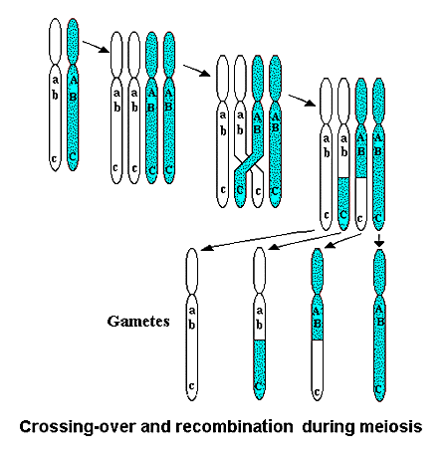
How are recombinants produced?
Ref: google images

Slide 17
Some questions!!
P1 Ab/Ab x aB/aB
F1 Ab/aB
How will you determine if loci A and B are linked?
Test Cross!!
Ab/aB X ab/ab
Ab/ab, aB/ab 90% - parental combinations
AB/ab, ab/ab 10% - recombinant
10% recombinant indicates that loci a and b are 10 map units apart.
Gene Map a________ b
10 m. u.

Slide 18
Recombinant frequency for Mapping
Mapping: Identification of the locus of gene in a chromosome.
The percentage of recombinants can be used as a quantitative index of genetic distance between 2 genes.
1 genetic map unit (m.u) = recombinant frequency of 1%
Example.
pr
11.0
vg

Slide 19
Determining the Gene order
A
5 m.u
B
A
3 m.u
C
A
3 m.u
Possible combined map A
C
B
5 m.u
C
A
B
Possible combined map B
5 m.u
3 m.u

Slide 20
One would look at the recombinant frequency of Gene B & Gene C

Slide 21
If recombinant frequency between B & C is 2, then model A is correct
A
3 m.u
Possible combined map A
C
B
5 m.u
If recombinant frequency between B & C is 8, then model B is correct
C
A
B
Possible combined map B
5 m.u
3 m.u

Slide 22
Quick Recap!!
The location of a gene on a chromosome is called the locus.
Two alleles of a gene in a heterozygote occupy corresponding positions in the homologous chromosomes.
Crossing over involves the breakage of homologous chromosomes and exchange of parts generating recombinant combination of linked genes.
Two genes producing a recombinant frequency of less than 50% are said to be linked

Slide 23
Gene Mapping
A
B
The rationale behind genetic mapping is that probability of crossover occuring between two loci is a function of distance between them
Potential crossover interval
a
b
A
C
Potential crossover interval
a
c

Slide 24
Determining the Gene order
AB =5mu
AC= 3 mu
CB= 8mu
C
A
B
5 m.u
3 m.u

Slide 25
Is recombinant frequency additive?
X
Y
Z
15 m.u
20 m.u
35 m.u
?

Slide 26
NO! FOR DISTANCE LARGER THAN 15mu -20mu

Slide 27
Deviations due to double crossover ???
15 m.u
C
A
B
25 m.u
< 40 m.u
If the distance is large, double cross can reduce the recombination frequency

Slide 28
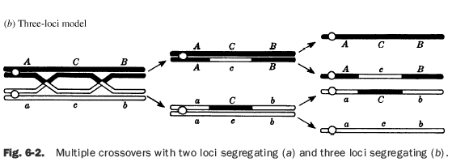
What is double cross over?
Because of double crossover the recombinant frequency between A and B loci may appear smaller than the actual distance

Slide 29
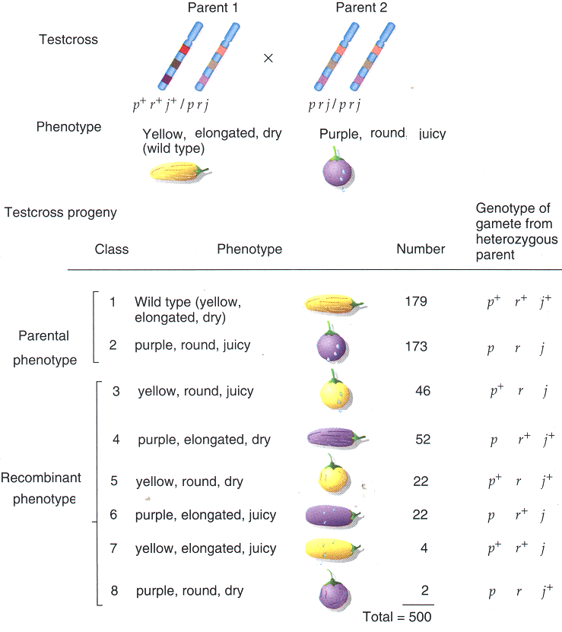
Let’s take an example
Parental genotypes are most frequent
Products of DCO are least frequent

Slide 30
How do determine the gene order?
A double crossover changes the orientation of the allelic pair in the middle of the three genes with respect to the flanking gene pairs.
j loci is between p and r

Slide 31
How to calculate the map distance?
Recombination frequency between p & j=
sco between p & j + dco X 100
Total no of progeny
(52+46) + (4+2)/ 500 X100 = 20.8%
Recombination frequency between j & r =
(22 +22) +(4+2)/500 X 100= 10%
p
20.8 m.u
j
r
10
m.u

Slide 32
Question??
A cross is made between homozygous wild-type female Drosophila (AABBCC) and triple-mutant males (aa bb cc) (the order here is arbitrary). The F1 (Aa Bb Cc) females are test crossed back to the triple-mutant males and the F2 phenotypic ratios are as follows:
“A b c” 18
“a B c” 112
“a b c” 308
“A B c” 66
“a b C” 59
“ABC” 321
“Ab C” 102
“a BC” 15
1000

Slide 33
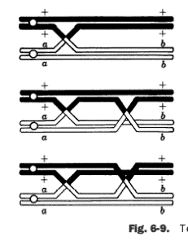
Types of Crossover
Single crossover
Three strand double crossover
three strand double crossover
Assignment – work out what percentage gametes will be recombinants?

